Slide 1

Wheaton College Android App
CSCI 335 Term Project

Slide 2
Goal
This semester our project has been to overhaul the Android app, giving it a facelift, fixing several bugs, adding three new features and generating some much-needed documentation.

Slide 3
Housekeeping improvements
Changed colors to match the iOS app.
Fixed several broken or disabled features.
Who's Who
Campus Map
Added new features to increase interest in app.
Ride Sharing Forum
Game Rankings
Prayer Board
Changed several things to affect User Experience.

Slide 4
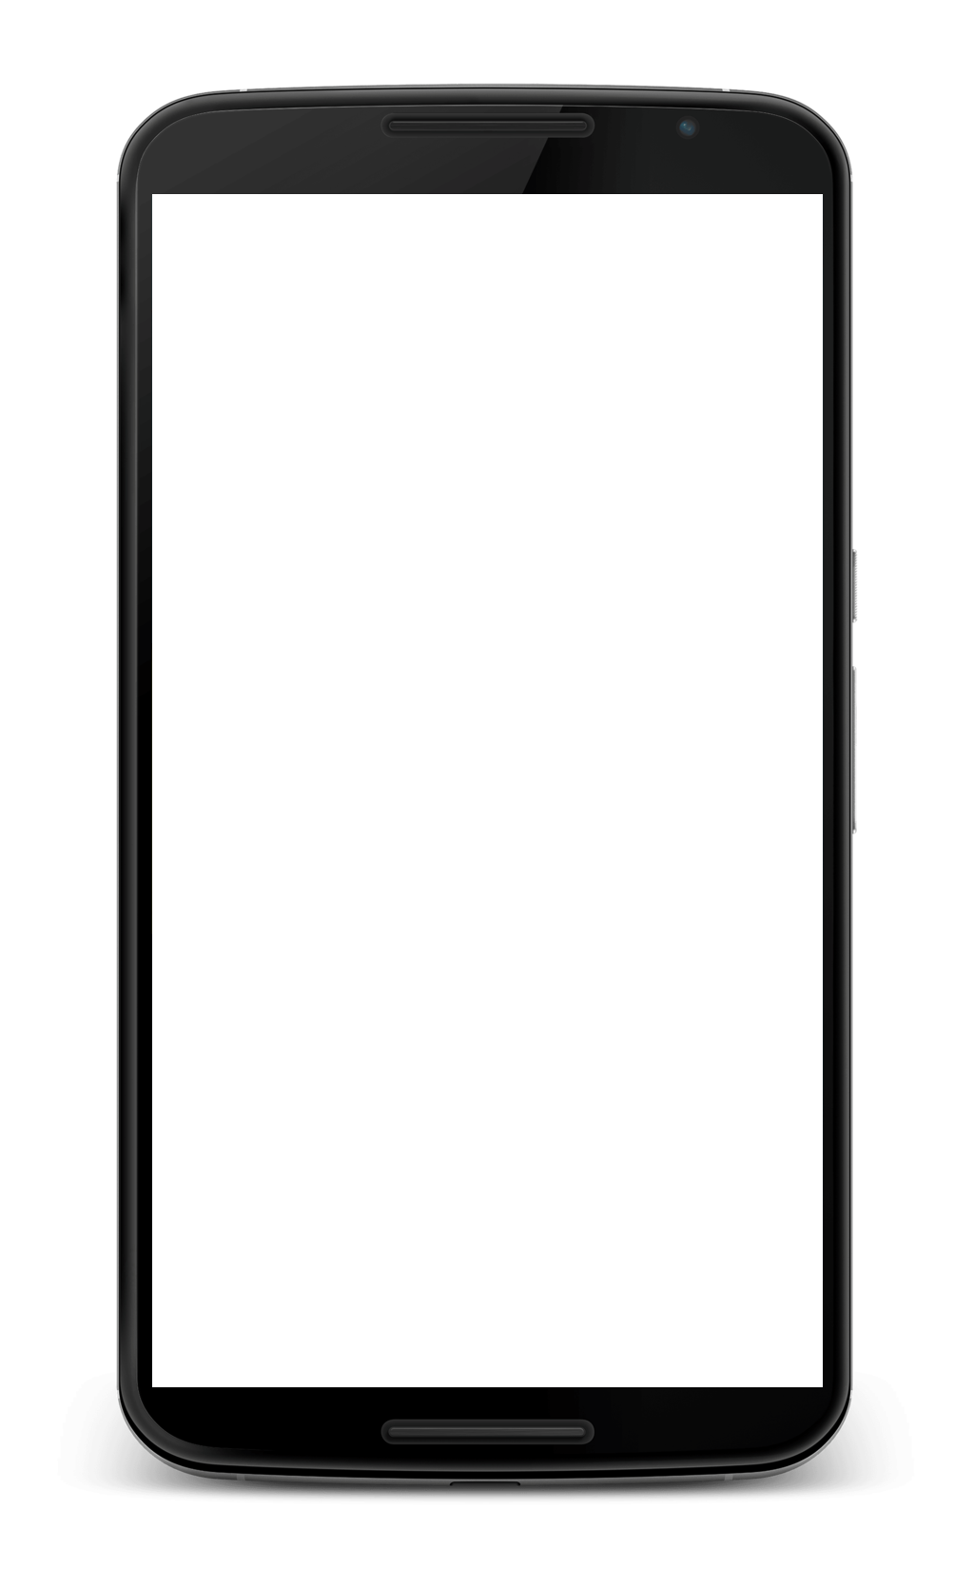
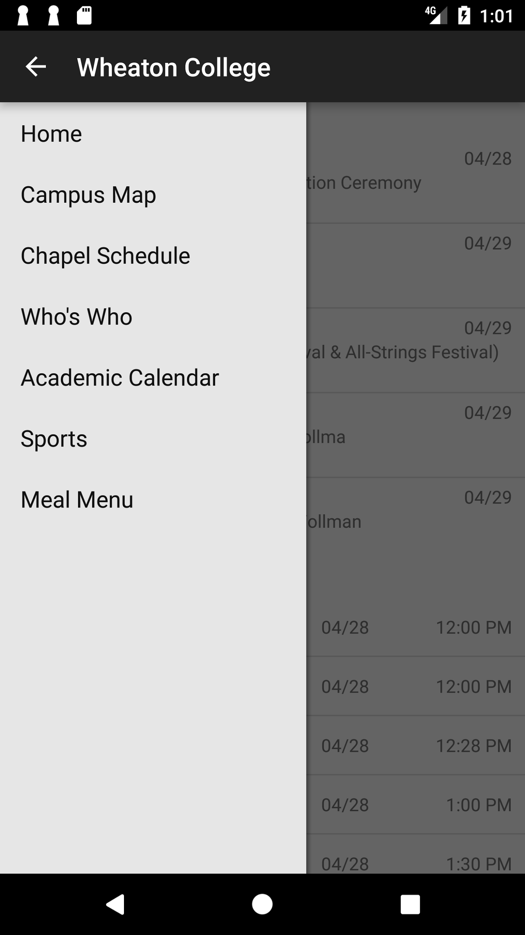
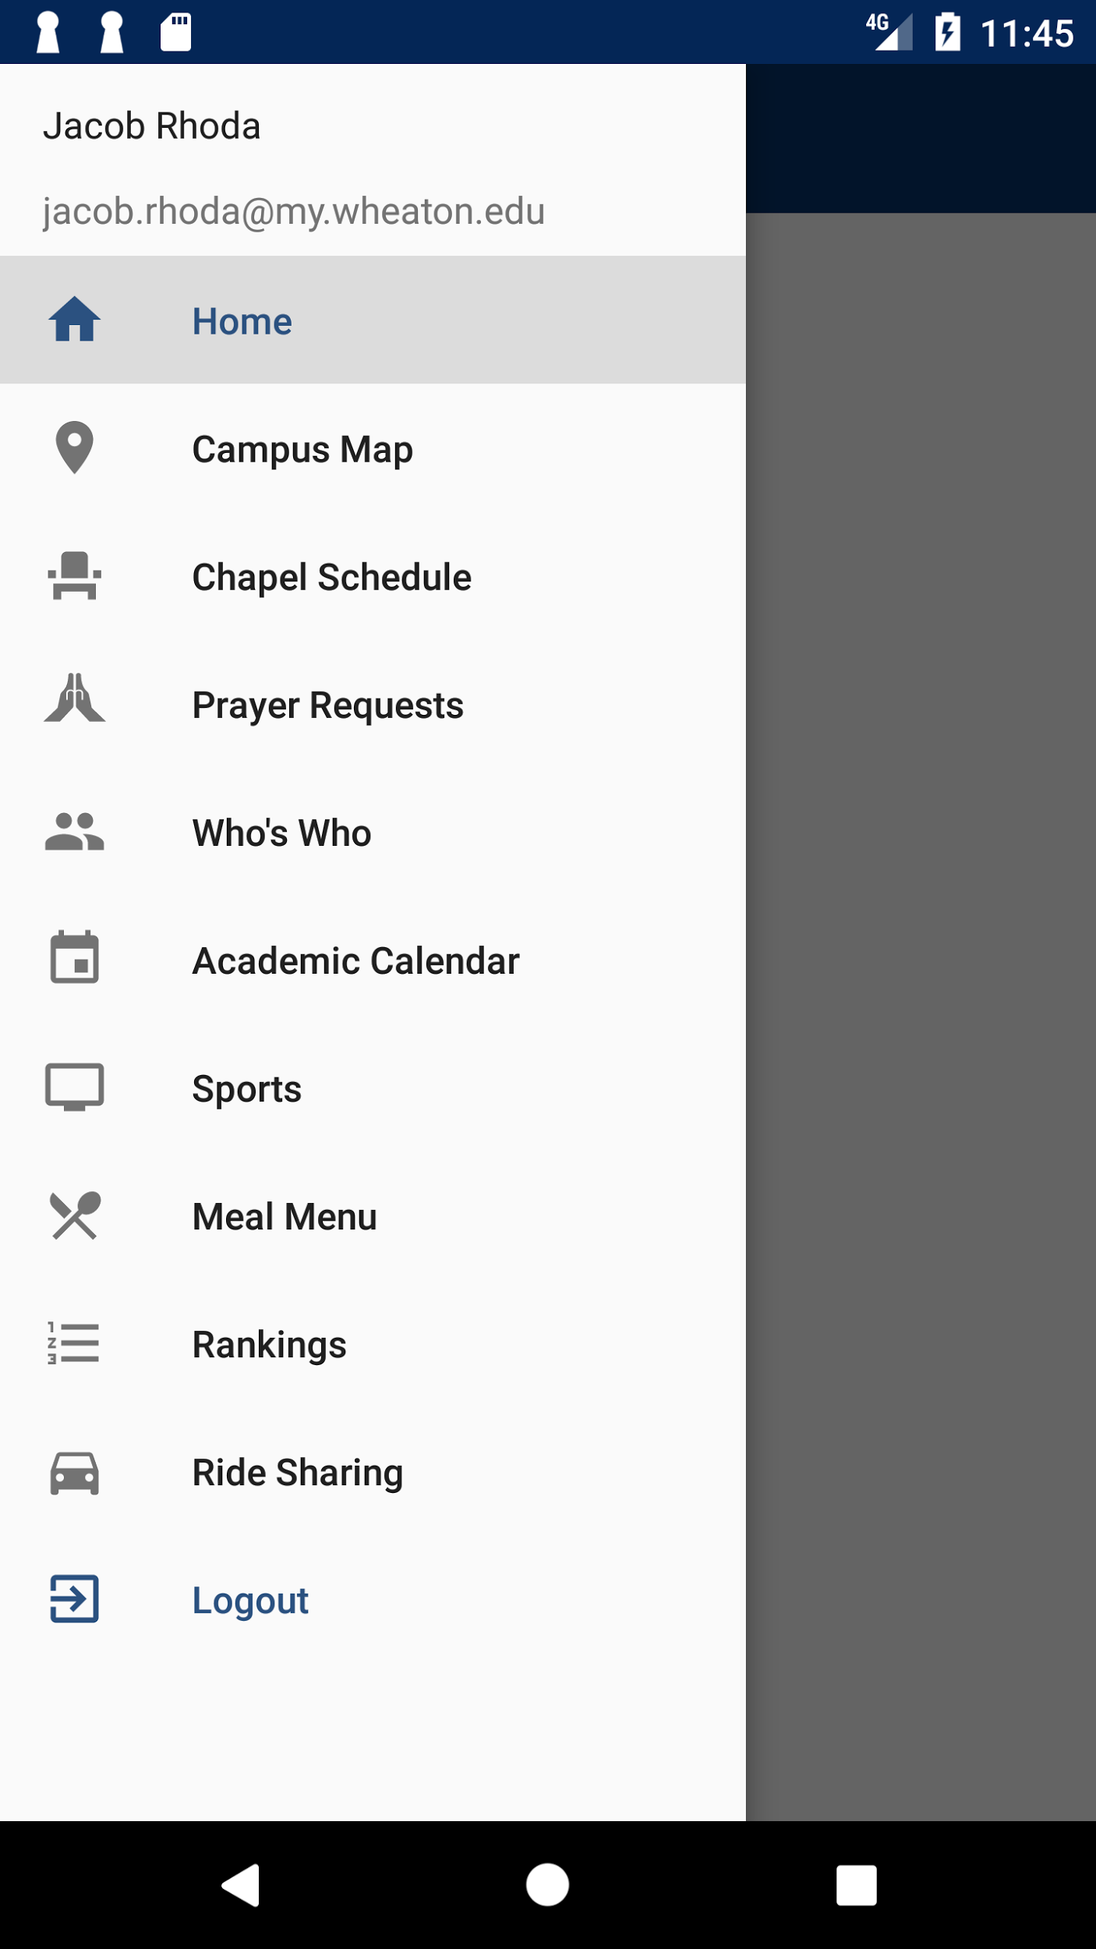
Before and after

Slide 5





Overview of main improvements

Slide 6
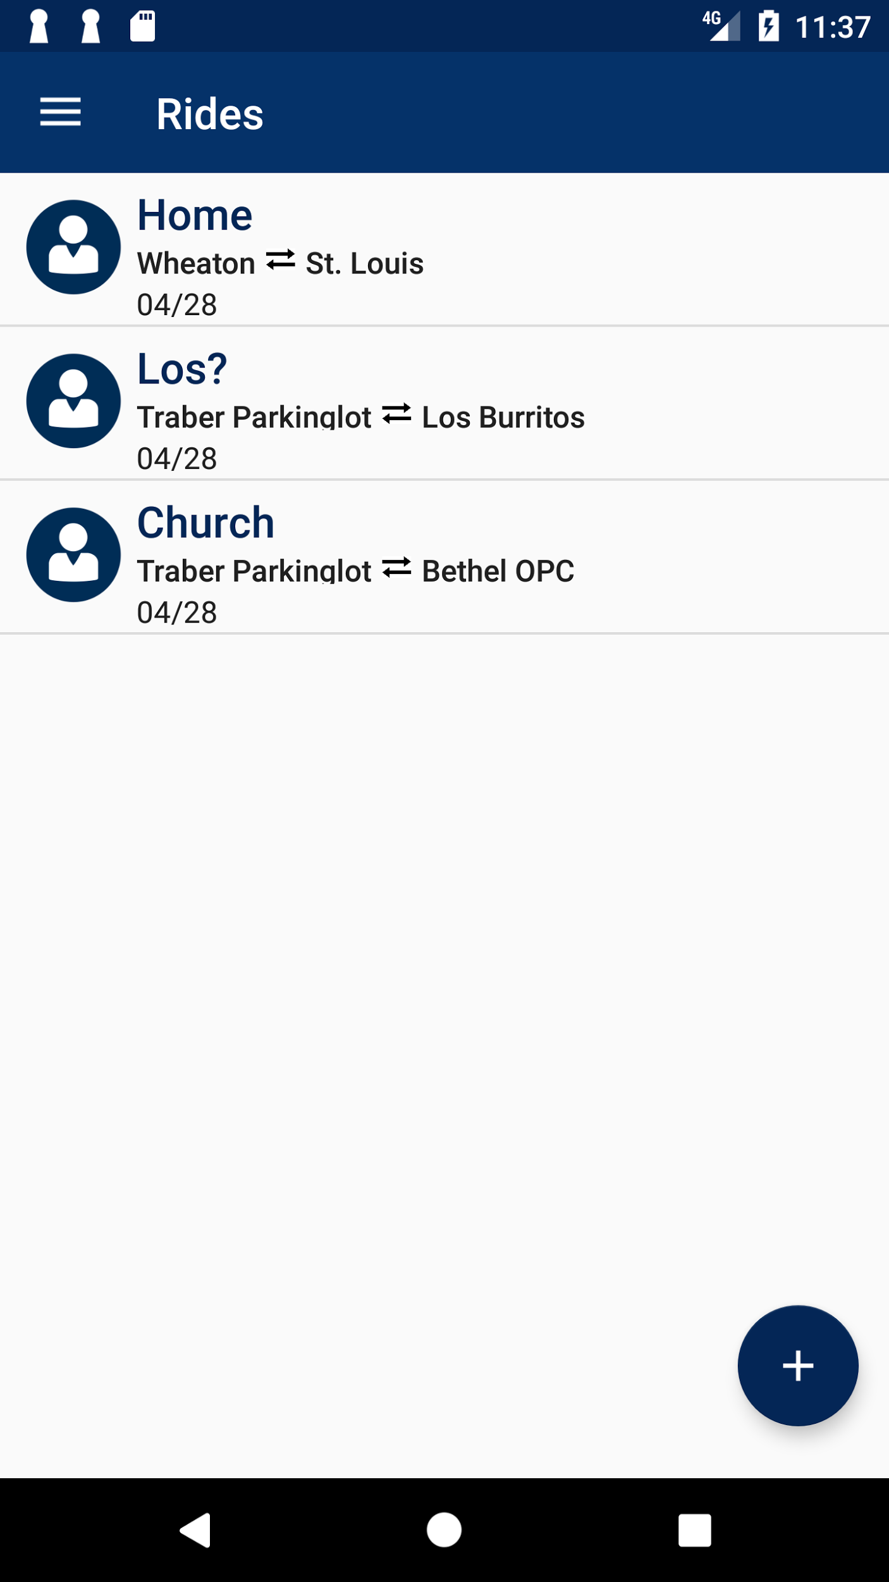
Ride Sharing Forum
Functionalities:
Post Ride
Search Ride
View Ride Details
Accessible only within College
Easy to Use
Intentional Community Guaranteed
Make Spontaneous Los Trip Possible

Slide 7
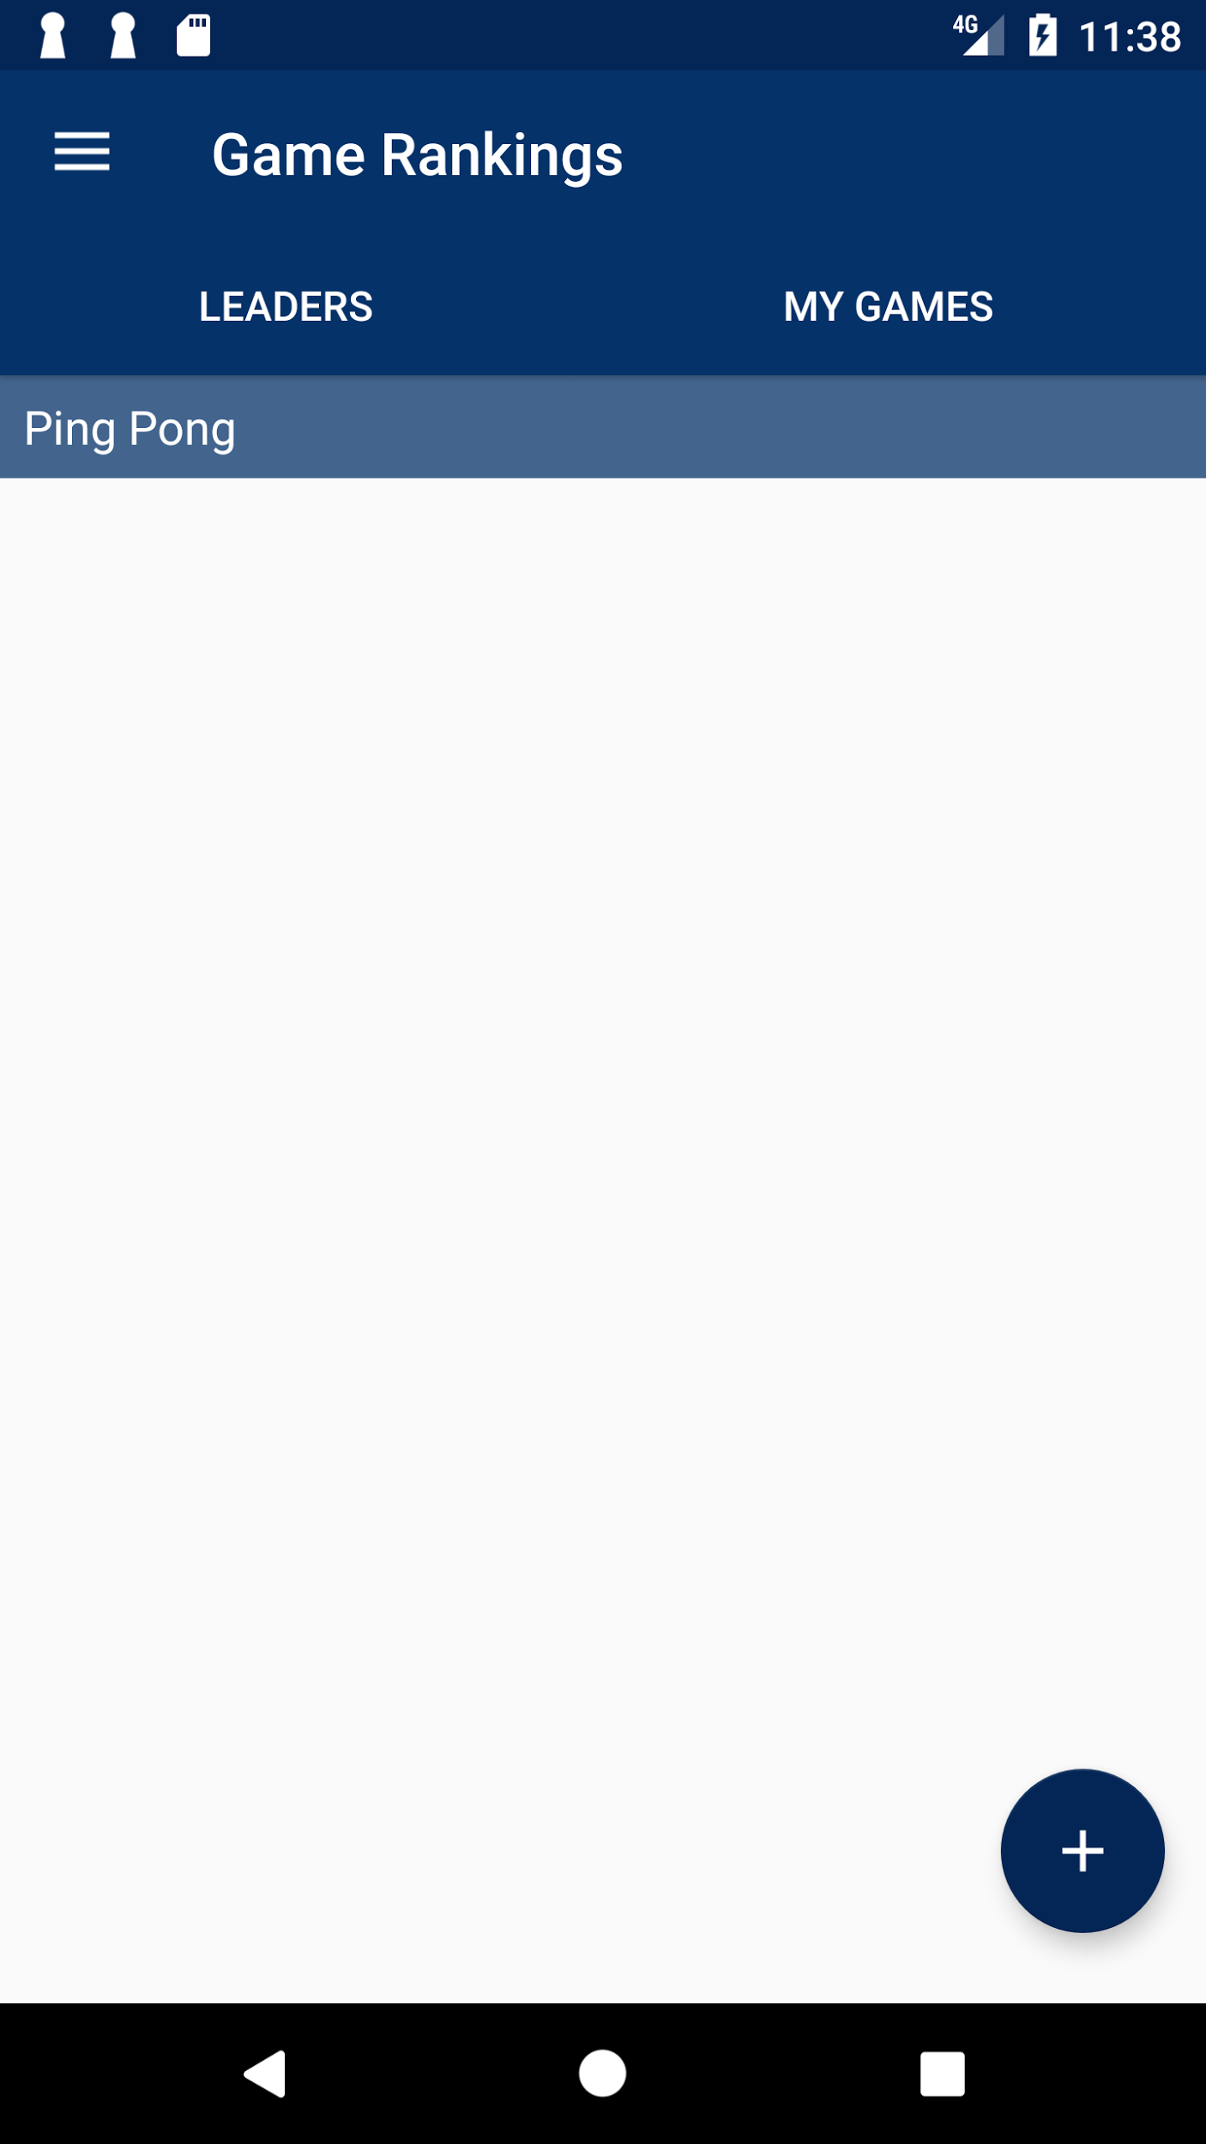
Rankings
Users can switch games
Users can add a game
Users can see leaders
Users can view their games
Validation

Slide 8
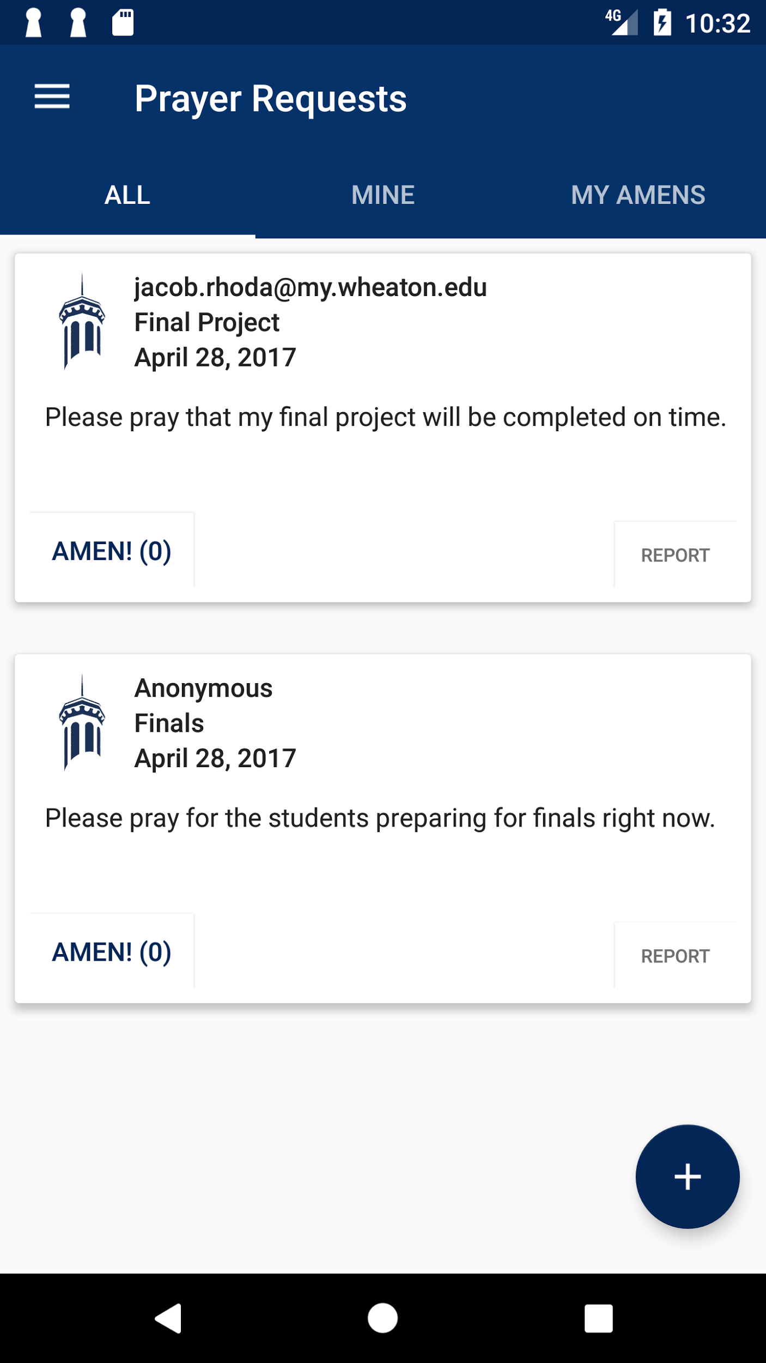
Prayer Board
Contained within college community
Anonymous / Public Posting
Allow for interaction via “Amen” button
Maintain positive atmosphere through report button

Slide 9
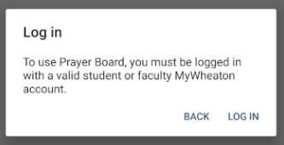
Only college accounts are allowed to login.

Slide 10
Design
Mockups and reused code
Consistent themes, fonts, colors
XML built from design information
Layouts, item files
Android specific design:
Connecting xml to java, styles.xml, colors.xml

Slide 11
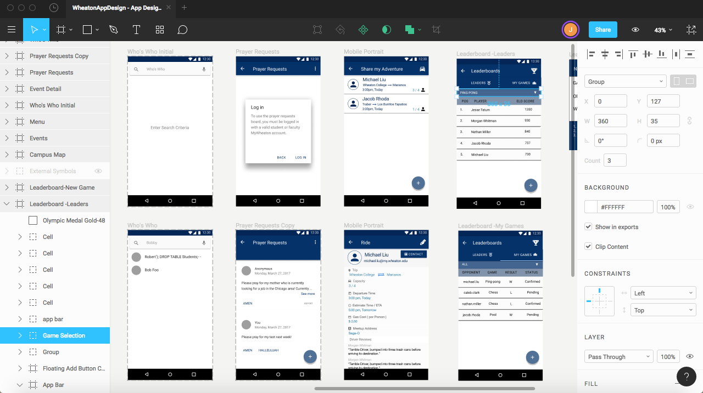
Design Process Beginnings: Mockups
Notes:
Consistent themes, fonts, colors

Slide 12
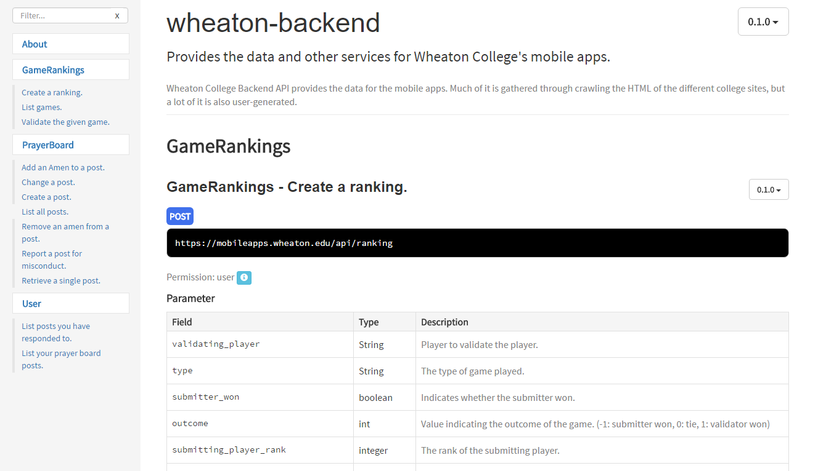
Backend API Documentation

Slide 13
Thank you!
Evan Cameron, Michelle Chuang, Caleb Clark, Aleks Glavnik, Ainslie Hartopo, Quin Kent, Michael Liu, Mitch McRay, Nathan Miller, Jacob Rhoda, Jesse Tatum, Morgan Whitman

